Slide 1
ETL and NoSQL Recitation
Data Engineering - Unit 3
12/03/2025

Slide 2
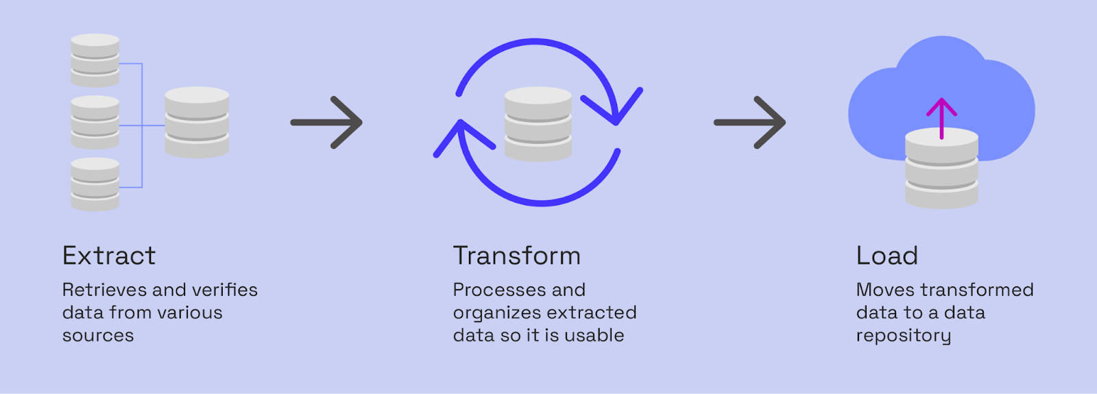
ELT

Slide 3
ELT

Slide 4
ELT

Slide 5
ELT

Slide 6
ETL - Example
App Logs (JSON): Contains user_id, timestamp, video_id, duration_watched. (Generated live, huge volume).
User Database (SQL): Contains user_id, email, age, country. (Structured, slow to change).
Content Metadata (CSV): Contains video_id, title, genre, director, origin_country. (Updated monthly).
TASK: What is the average watch time for 'Sci-Fi' movies by users in 'France'?

Slide 7
ETL - Example
App Logs (JSON): Contains user_id, timestamp, video_id, duration_watched. (Generated live, huge volume).
User Database (SQL): Contains user_id, email, age, country. (Structured, slow to change).
Content Metadata (CSV): Contains video_id, title, genre, director, origin_country. (Updated monthly).
TASK: What is the average watch time for 'Sci-Fi' movies by users in 'France'?
Which strategy would you use for the App Logs extraction? Full or Partial/Incremental?

Slide 8
ETL - Example
App Logs (JSON): Contains user_id, timestamp, video_id, duration_watched. (Generated live, huge volume).
User Database (SQL): Contains user_id, email, age, country. (Structured, slow to change).
Content Metadata (CSV): Contains video_id, title, genre, director, origin_country. (Updated monthly).
TASK: What is the average watch time for 'Sci-Fi' movies by users in 'France'?
The App Logs sometimes have a duration_watched of -1 or null. How should your pipeline handle these rows?

Slide 9
ETL - Example
App Logs (JSON): Contains user_id, timestamp, video_id, duration_watched. (Generated live, huge volume).
User Database (SQL): Contains user_id, email, age, country. (Structured, slow to change).
Content Metadata (CSV): Contains video_id, title, genre, director, origin_country. (Updated monthly).
TASK: What is the average watch time for 'Sci-Fi' movies by users in 'France'?
The User DB lists countries as "US", "FR", "UK", but the Content Metadata uses "United States", "France", "United Kingdom". What transformation step is needed here?

Slide 10
ETL - Example
App Logs (JSON): Contains user_id, timestamp, video_id, duration_watched. (Generated live, huge volume).
User Database (SQL): Contains user_id, email, age, country. (Structured, slow to change).
Content Metadata (CSV): Contains video_id, title, genre, director, origin_country. (Updated monthly).
TASK: What is the average watch time for 'Sci-Fi' movies by users in 'France'?
Would you reload the entire report every day (Bulk Load) or just add the new day's data (Incremental)?

Slide 11
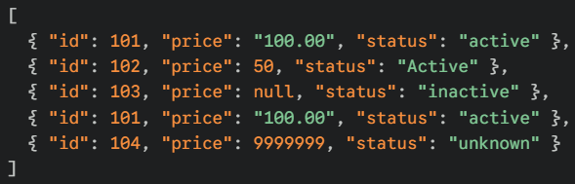
Data Cleaning
What are potential issues with this data and how can they be addressed?

Slide 12
MongoDB - NoSQL Activity

